Slide 1

Principles Of Scientific Management
Dr Samad Baseer

Slide 2


What do you think motivates people to come to work each morning?

Slide 3
Theory X and Theory Y
Do you believe that they get great satisfaction from their work and take pride in doing the best possible job?
In the 1960s, social psychologist Douglas McGregor developed two contrasting theories that explained how managers' beliefs about what motivates their people can affect their management style.
He labelled these Theory X and Theory Y.

Slide 4
Theory X and Theory Y
Theory X managers tend to take a pessimistic view of their people, and assume that they are naturally unmotivated and dislike work.
As a result, they think that team members need to be prompted, rewarded or punished constantly to make sure that they complete their tasks.

Slide 5
Theory X and Theory Y
Work in organizations that are managed like this can be repetitive, and people are often motivated with a "carrot and stick" approach.
Performance appraisals and remuneration are usually based on tangible results, such as sales figures or product output, and are used to control staff and "keep tabs" on them.

Slide 6
Theory X and Theory Y
This style of management assumes that workers:
Dislike their work.
Avoid responsibility and need constant direction.
Have to be controlled, forced and threatened to deliver work.
Need to be supervised at every step.
Have no incentive to work or ambition, and therefore need to be enticed by rewards to achieve goals.

Slide 7
Theory X and Theory Y
Theory Y managers have an optimistic, positive opinion of their people, and they use a decentralized, participative management style.
This encourages a more collaborative , trust-based relationship between managers and their team members.

Slide 8
Theory X and Theory Y
People have greater responsibility, and managers encourage them to develop their skills and suggest improvements.
Appraisals are regular but, unlike in Theory X organizations, they are used to encourage open communication rather than control staff.

Slide 9
Theory X and Theory Y
This style of management assumes that workers are:
Happy to work on their own initiative.
More involved in decision making.
Self-motivated to complete their tasks.
Enjoy taking ownership of their work.
Seek and accept responsibility, and need little direction.
View work as fulfilling and challenging.
Solve problems creatively and imaginatively.

Slide 10
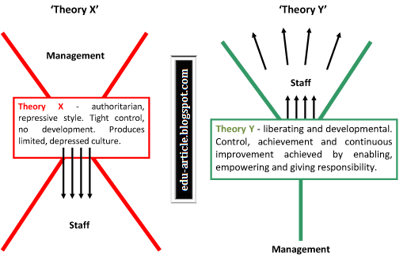

Slide 11
Conclusion
Theory Y has become more popular among organizations. This reflects workers' increasing desire for more meaningful careers that provide them with more than just money.
It's also viewed by McGregor as superior to Theory X, which, he says, reduces workers to "cogs in a machine," and likely demotivates people in the long term.

Slide 12
Maslow's Hierarchy of Needs

Slide 13
Introduction
Maslow's hierarchy of needs is a theory by Abraham Maslow, which puts forward that people are motivated by five basic categories of needs: physiological, safety, love, esteem, and self-actualization.

Slide 14
Key Takeaways: Maslow’s Hierarchy of Needs
According to Maslow, we have five categories of needs: physiological, safety, love, esteem, and self-actualization.
In this theory, higher needs in the hierarchy begin to emerge when people feel they have sufficiently satisfied the previous need.
Although later research does not fully support all of Maslow’s theory, his research has impacted other psychologists and contributed to the field of positive psychology.

Slide 15
Introduction
In order to better understand what motivates human beings, Maslow proposed that human needs can be organized into a hierarchy.
This hierarchy ranges from more concrete needs such as food and water to abstract concepts such as self-fulfillment.
According to Maslow, when a lower need is met, the next need on the hierarchy becomes our focus of attention.

Slide 16
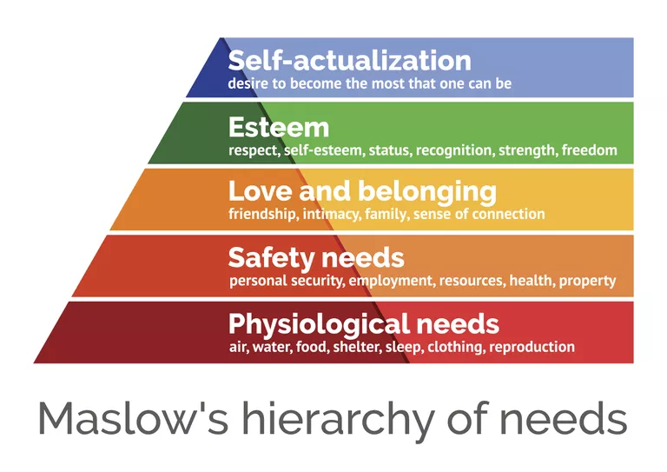
Key Takeaways: Maslow’s Hierarchy of Needs

Slide 17
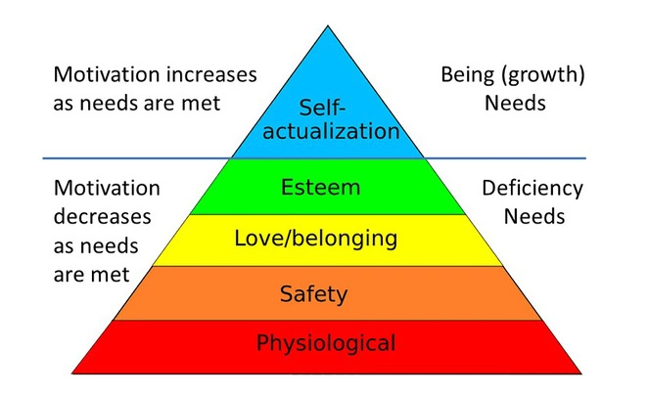

Slide 18
Maslow Theory of Needs
Every person is capable and has the desire to move up the hierarchy toward a level of self-actualization.
Unfortunately, progress is often disrupted by a failure to meet lower level needs.
Life experiences, including divorce and loss of a job, may cause an individual to fluctuate between levels of the hierarchy.
Therefore, not everyone will move through the hierarchy in a uni-directional manner but may move back and forth between the different types of needs.

Slide 19
1. Physiological
These refer to basic physical needs like drinking when thirsty or eating when hungry.
Maslow considered physiological needs to be the most essential of our needs.
If someone is lacking in more than one need, they’re likely to try to meet these physiological needs first.
For example, if someone is extremely hungry, it’s hard to focus on anything else besides food. Another example of a physiological need would be the need for adequate sleep.

Slide 20
2. Safety
Once people’s physiological requirements are met, the next need that arises is a safe environment.
Our safety needs are apparent even early in childhood, as children have a need for safe and predictable environments and typically react with fear or anxiety when these are not met.
Maslow pointed out that in adults living in developed nations, safety needs are more apparent in emergency situations (e.g. war and disasters), but this need can also explain why we tend to prefer the familiar or why we do things like purchase insurance and contribute to a savings account.

Slide 21
3. Love and Belonging
According to Maslow, the next need in the hierarchy involves feeling loved and accepted. This need includes both romantic relationships as well as ties to friends and family members.
It also includes our need to feel that we belong to a social group. Importantly, this need encompasses both feeling loved and feeling love towards others.
Since Maslow’s time, researchers have continued to explore how love and belonging needs impact well-being.
For example, having social connections is related to better physical health and, conversely, feeling isolated (i.e. having unmet belonging needs) has negative consequences for health and well-being.

Slide 22
4. Esteem
Our esteem needs involve the desire to feel good about ourselves.
According to Maslow, esteem needs include two components. The first involves feeling self-confidence and feeling good about oneself.
The second component involves feeling valued by others; that is, feeling that our achievements and contributions have been recognized by other people.
When people’s esteem needs are met, they feel confident and see their contributions and achievements as valuable and important.
However, when their esteem needs are not met, they may experience what psychologist Alfred Adler called “feelings of inferiority.”

Slide 23
5. Self-Actualization
Self-actualization refers to feeling fulfilled, or feeling that we are living up to our potential. One unique feature of self-actualization is that it looks different for everyone.
For one person, self-actualization might involve helping others; for another person, it might involve achievements in an artistic or creative field.
Essentially, self-actualization means feeling that we are doing what we believe we are meant to do. According to Maslow, achieving self-actualization is relatively rare, and his examples of famous self-actualized individuals include Abraham Lincoln, Albert Einstein, and Mother Teresa.

Slide 24
Hierarchy of needs summary
(a) human beings are motivated by a hierarchy of needs.
(b) needs are organized in a hierarchy of prepotency in which more basic needs must be more or less met (rather than all or none) prior to higher needs.
(c) the order of needs is not rigid but instead may be flexible based on external circumstances or individual differences.
(d) most behavior is multi-motivated, that is, simultaneously determined by more than one basic need.

Slide 25
Thank You

